Slide 1


Artificiële Intelligentie
RCA AIG 04Q6 08 APRIL 2021
Computational Foundations of
Machine Learning [ML]
with Python
DataLab
Rob van der Willigen

Slide 2
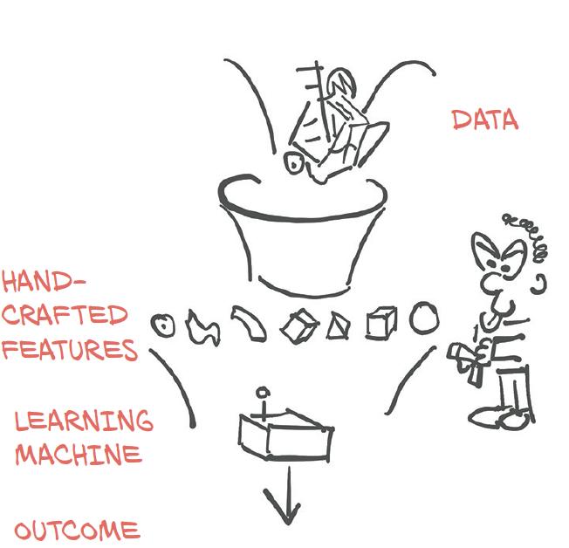
MACHINE LEARNING [ML]
Interactive Visual experimentation
with ML models & hyperparameters

Slide 3


CONTEXT
Prerequisites: basics in linear algebra, probability, and analysis of algorithms.
Workload: homework assignments
GitHub: Start a ML repository at GitHub

Slide 4
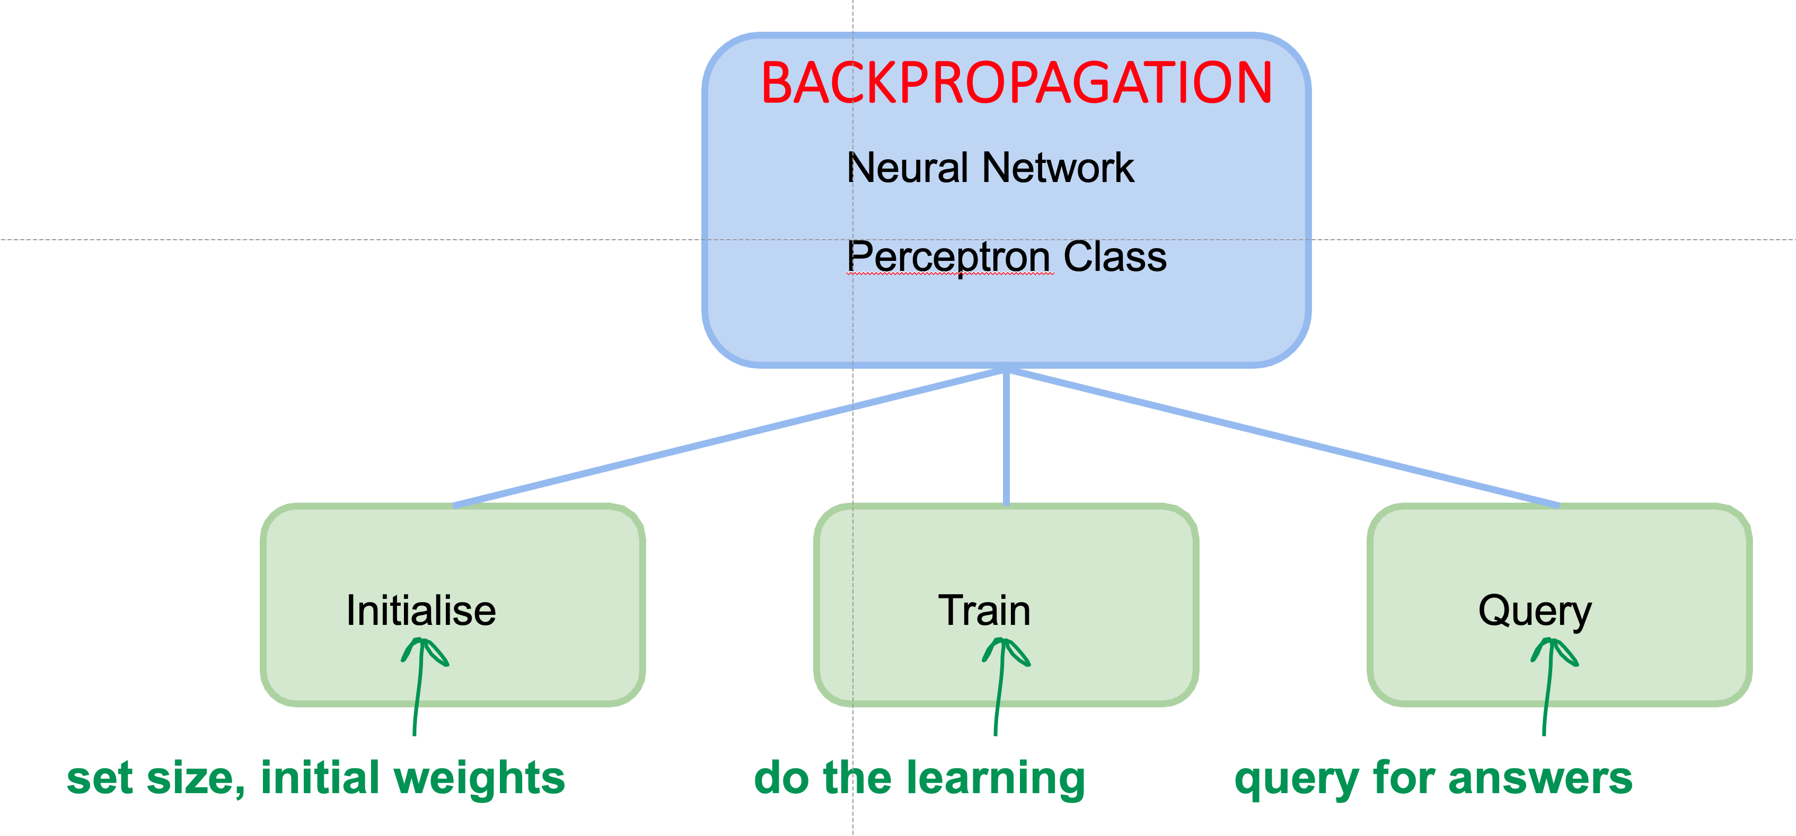
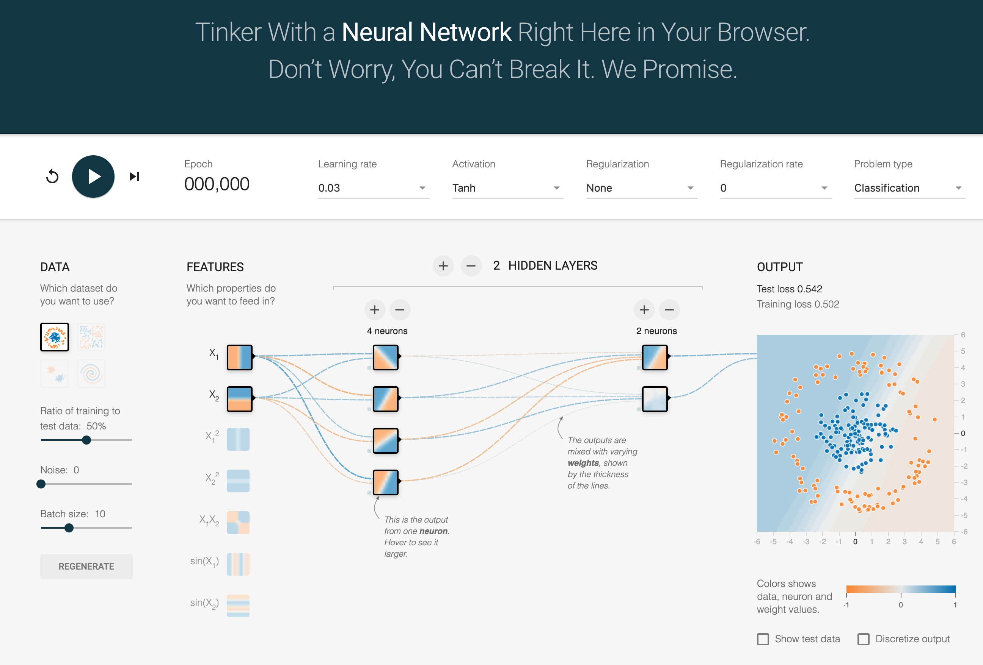
Lecture 05
Basic deﬁnitions and concepts of Machine Learning (ML) PART03. How to get from ML concepts & Models to Python code. ➔How to explain/design a Neural Network ⬅ TENSORFLOW PLAYGROUND

Slide 5
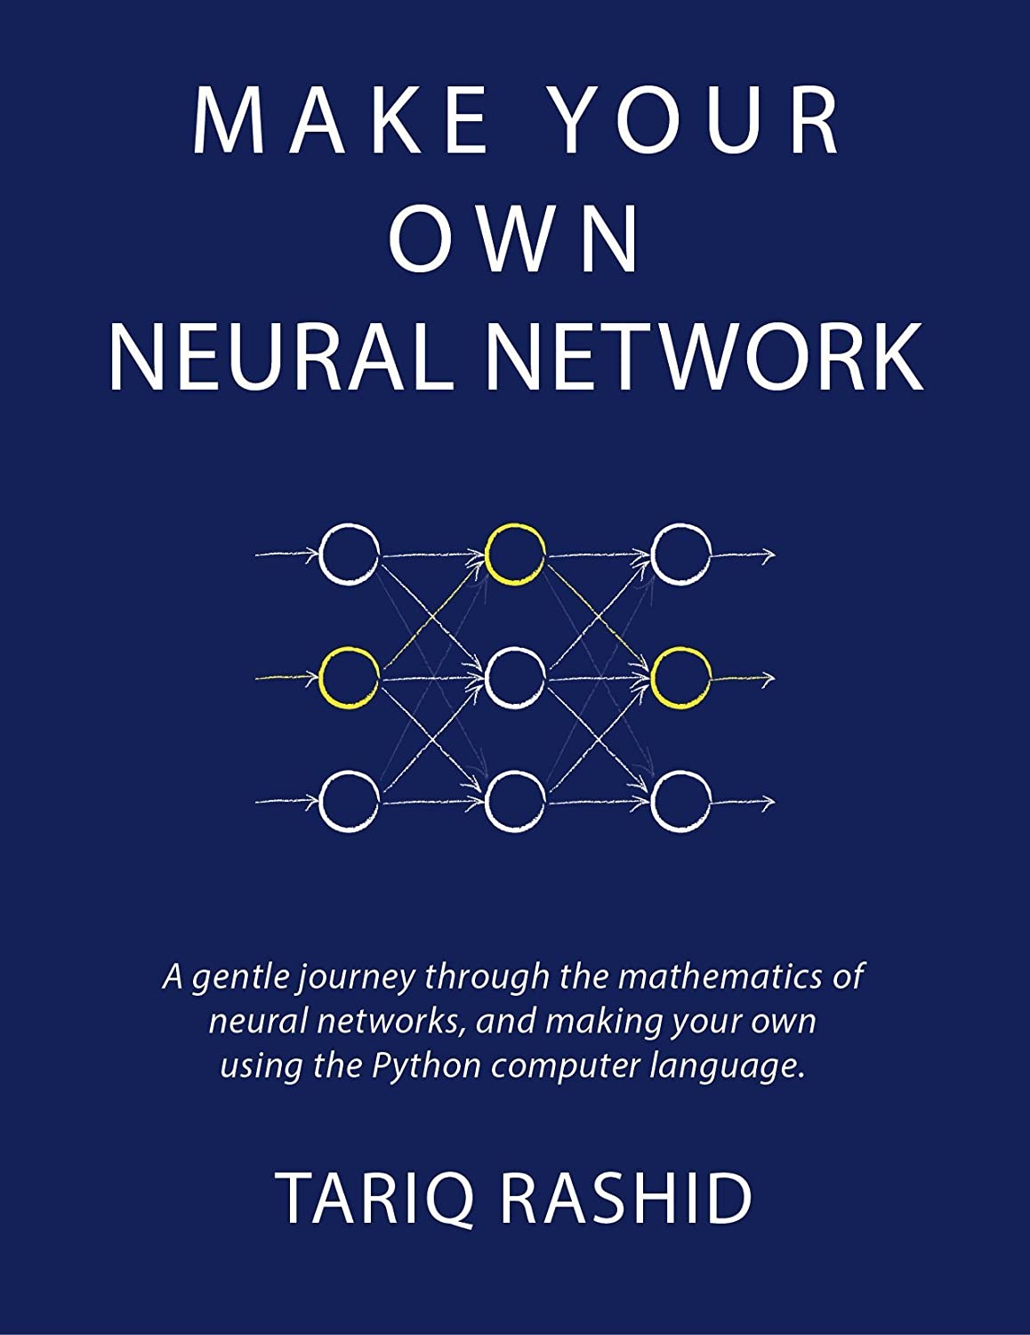
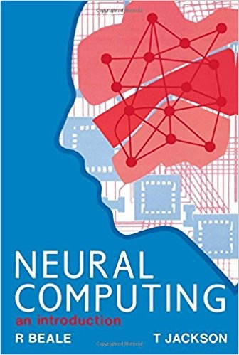
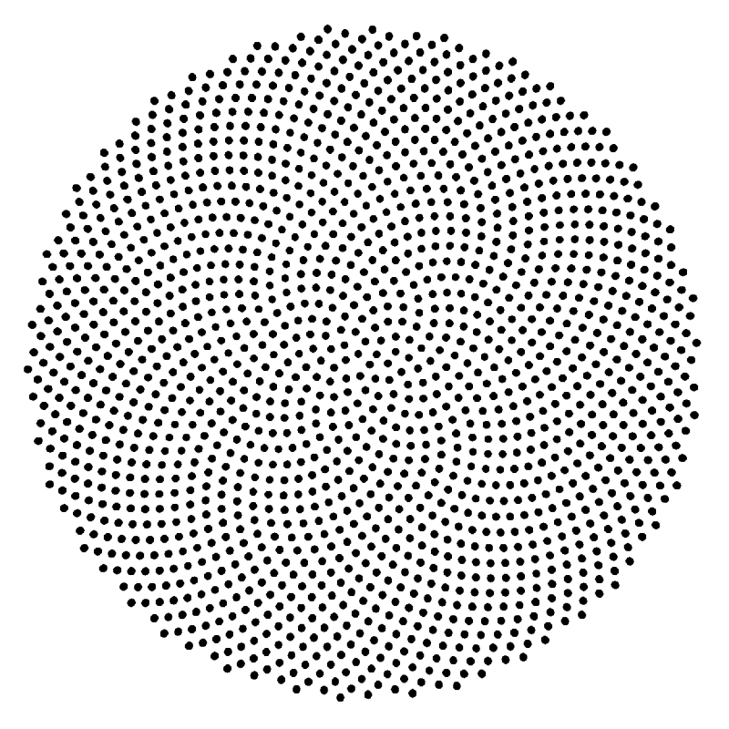
{01}
Fundamentals

Slide 6
{01}
Fundamentals
Artificial Neuron
Understanding Neural Networks
https://developers.google.com/machine-learning/crash-course/introduction-to-neural-networks/playground-exercises
https://poloclub.github.io/cnn-explainer/

Slide 7
{01}
Fundamentals
Artificial Neuron
Neural Networks
Need both a Cookbook & a Infrastructure
Neural networks aim to mimic the human brain—
and one way to think about the brain is that
it works by accreting smaller abstractions into larger ones.
Complexity of thought, in this view,
is then measured by the range of smaller abstractions you can draw on, and the number of times you can combine lower-level abstractions into higher-level abstractions like the way we learn to distinguish dogs from birds
https://www.wired.com/story/neural-networks-need-a-cookbook-here-are-the-ingredients/

Slide 8
{01}
Fundamentals
Artificial Neuron
Neural Networks
Need both a Cookbook & a Infrastructure
“For a human, if you’re learning how to recognize a dog you’d learn to recognize four legs, fluffy,” said Maithra Raghu, a doctoral student in computer science at Cornell University and a member of Google Brain.
“Ideally we’d like our neural networks to do the same kinds of things.”
https://www.wired.com/story/neural-networks-need-a-cookbook-here-are-the-ingredients/

Slide 9
{01}
Fundamentals
Artificial Neuron
Neural Networks
Need both a Cookbook & a Infrastructure
Abstraction comes naturally to the human brain.
Neural networks have to work for it.
As with the brain, neural networks are made of building blocks called “neurons” that are connected in various ways.
The neurons in a neural network are inspired by neurons in the brain but do not imitate them directly.
Each neuron might represent an attribute, or a combination of attributes, that the network considers at each level of abstraction.
https://www.wired.com/story/neural-networks-need-a-cookbook-here-are-the-ingredients/

Slide 10
{01}
Fundamentals
Artificial Neuron
Neural Networks
Need both a Cookbook & a Infrastructure
When joining these neurons together, engineers have many choices to make. They have to decide how many layers of neurons the network should have (or how “deep” it should be).
Consider, for example, a neural network with the task of recognizing objects in images.
The image enters the system at the first layer. At the next layer, the network might have neurons that simply detect edges in the image. The next layer combines lines to identify curves in the image.
Then the next layer combines curves into shapes and textures, and the final layer processes shapes and textures to reach a conclusion about what it’s looking at: woolly mammoth!
https://www.wired.com/story/neural-networks-need-a-cookbook-here-are-the-ingredients/

Slide 11
{01}
Fundamentals
Artificial Neuron
Neural Networks
Need both a Cookbook & a Infrastructure
“The idea is that each layer combines several aspects of the previous layer. A circle is curves in many different places, a curve is lines in many different places,” said David Rolnick, a mathematician at the University of Pennsylvania.
Engineers also have to decide the “width” of each layer, which corresponds to the number of different features the network is considering at each level of abstraction. In the case of image recognition, the width of the layers would be the number of types of lines, curves or shapes it considers at each level.
Beyond the depth and width of a network, there are also choices about how to connect neurons within layers and between layers, and how much weight to give each connection.
https://www.wired.com/story/neural-networks-need-a-cookbook-here-are-the-ingredients/

Slide 12
{01}
Fundamentals
Simple Predicting Machine
Neural Networks
Architecture Building blocks
Neural Networks typically consist of three layers:
Input layer: This is the first layer of the neural network which passes the information to subsequent layers without performing any computational tasks.
Hidden layer: This consists of one or more layers and acts as the connection between the input and output layer. These layers perform all the computational work.
Output layer: This layer is responsible for transferring the data to the outside world.
Each layer can have one or many nodes.
The neural network having hidden layers with one or more neurons is called a ‘Deep Neural Network.’
This type of model is used in various applications of machine learning such as machine translation, image processing, speech recognition, image recognition, etc.

Slide 13
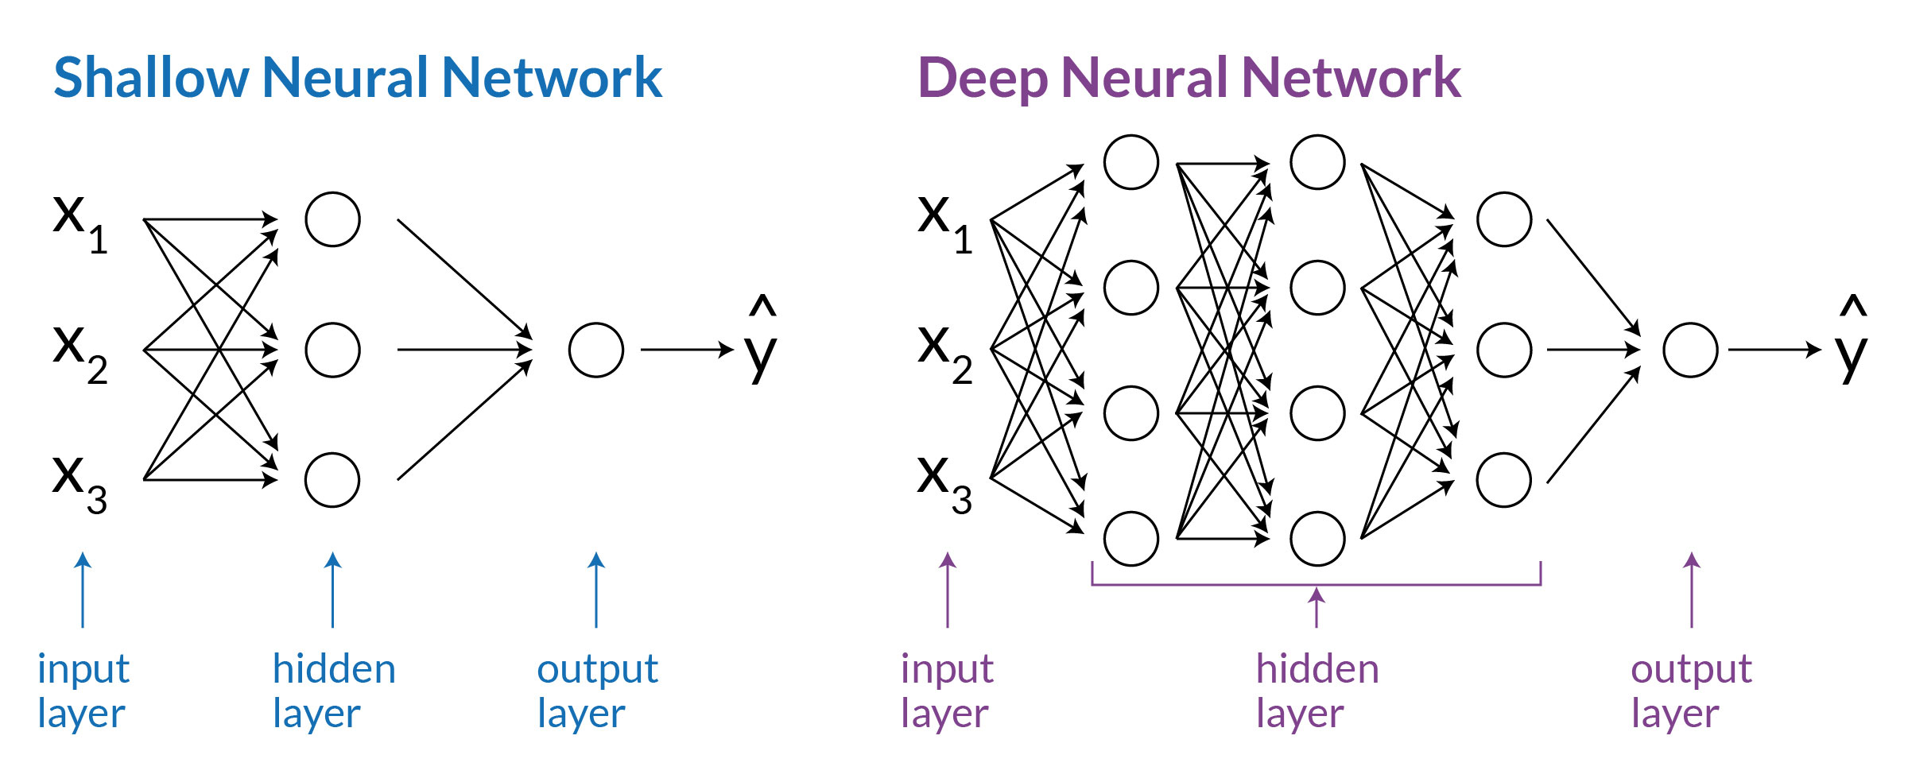
Neural Networks
Need Infrastructure: Network Architecture
{01}
Fundamentals
Simple Predicting Machine
The neural network having multiple hidden layers with one or more neurons is called a ‘Deep Neural Network.’
This type of model is used in various applications of machine learning such as machine translation, image processing, speech recognition, image recognition, etc.

Slide 14
{01}
Fundamentals
Simple Predicting Machine
Neural Network [hyper]Parameters
Epoch:
An epoch is one complete cycle when the entire dataset is passed forward and backward through the neural network once.
Learning rate:
Learning rate is a configurable hyperparameter (the properties/parameters that govern the whole Neural Network training process) used in the training of neural networks that has a small positive value. The learning rate ranges from 0.00001 to 10 in the Tensorflow playground.
It controls how quickly the model weights are adapted to the problem. Smaller learning rates require more training epochs given the smaller changes made to the weights each update, whereas larger learning rates result in rapid changes and require fewer training epochs. If too high, we may miss some or most minima.
Result: erratic performance or never achieving a low loss.
If too low, learning will take longer than necessary
Activation function:
This is the function in an artificial neuron that delivers an output based on inputs.
ReLU, Tanh, Sigmoid, and Linear are available activation functions
in the Tensorflow playground.
Note: The output of each function is used as an input in the next function
in each epoch until we get the desired solution.
https://www.druva.com/blog/understanding-neural-networks-through-visualization/

Slide 15
{01}
Fundamentals
Simple Predicting Machine
Neural Network [hyper] Parameters
The ratio of the training and testing sets
Every given dataset is divided into categories: testing and training sets.
The training set is the set of data that is used to train the neural network to get the desired output.
The testing set is the set of data that is used to test the model prediction capability, on an unseen data set.
We usually set that ratio to 70/30 or 80/20.
Regularization type + rate:
This is a technique used for tuning the activation function by adding an additional penalty term in the error function.
The value of the regularization rate varies from 0 to 10 in the Tensorflow playground.).
Parameter to control overfitting, i.e. when the model does well on training data but poorly on new, unseen data
L2 regularization is the most common. Using dropout is another common way of controlling overfitting in neural networks. At each training stage, some hidden nodes temporarily removed (dropped out).
Features
Features are the properties of the node or neuron that we want to feed in during the artificial neural network generation. There are a number of properties to choose from in the Tensorflow Playground.
Noise
Noise is a distortion in data, that is unwanted by the perceiver of data. Adding noise to inputs is like telling the network to not change the output in a ball around your exact input.
https://www.druva.com/blog/understanding-neural-networks-through-visualization/

Slide 16
{01}
Fundamentals
Simple Predicting Machine
Neural Network Direct manipulation through the Tensorflow Playground
A student who wishes to learn about Neural Networks (NN) & Machine Learning (ML) needs to develop a mental model of not only NN architecture & ML algorithms,
but also how they affect each other in its training process.
The crux in learning about NN & ML, therefore, originates from
the iterative, dynamic, intricate interplay between NN architecture & ML algorithms.
Such complex interaction is challenging for novices to recognize, and sometimes even for experts to fully understand.
Typical NN architecture diagrams + hyper parameterization do not help students to develop the crucial mental models needed for a thorough understanding of ML-based AI.
GAN Lab: Understanding Complex Deep Generative Models using Interactive Visual Experimentation https://doi.org/10.1109/TVCG.2018.2864500 - https://poloclub.github.io/ganlab/

Slide 17
{01}
Fundamentals
Simple Predicting Machine
Neural Network
direct & iterative (experimental)manipulation
through the Tensorflow Playground
In the following neural network (NN) manipulation experiments,
we will learn to use the Tensorflow Playground
as CONCEPTUAL model to explain, learn & build neural networks
that use Machine Learning (ML)
to solve REGESSION & CLASSIFICATION Tasks
https://cloud.google.com/blog/products/ai-machine-learning/understanding-neural-networks-with-tensorflow-playground

Slide 18
{01}
Fundamentals
Simple Predicting Machine
TENSORFLOW PLAYGROUND
Learning Problem (non-linear vs linear)
TENSORFLOW PLAYGROUND Problem type:
Problem type is broadly classified into two parts: classification and regression.
Classification problems are those problems that have categorical output,
e.g., an artificial neural network used to identify dog vs cat.
In these scenarios, the output is either of the two categories, i.e cat or dog.
In regression problems, the output is a numerical value ranging from starting and ending point (e.g., an artificial neural network used to identify dog vs cat, the output can also be shaped as a percentage match as dog or cat.
In this scenario, the output lies between 0–100).

Slide 19
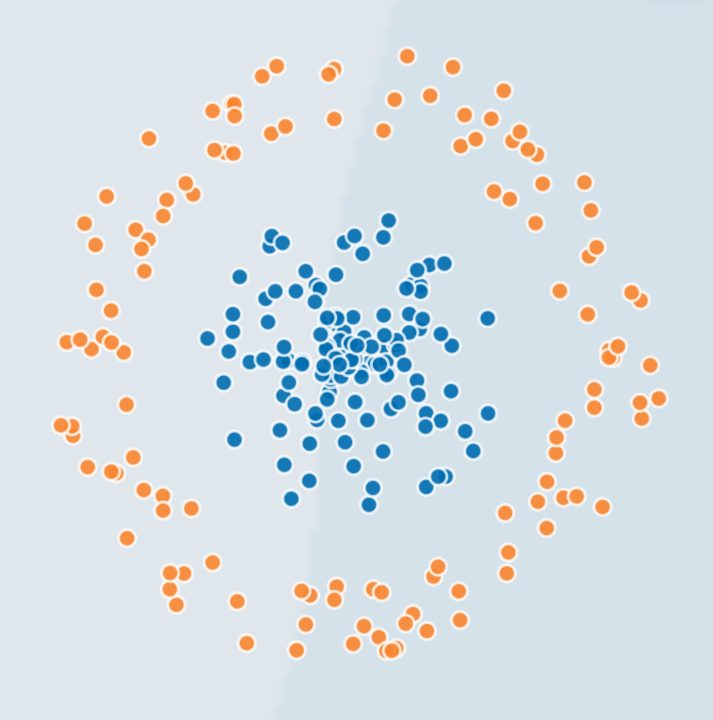
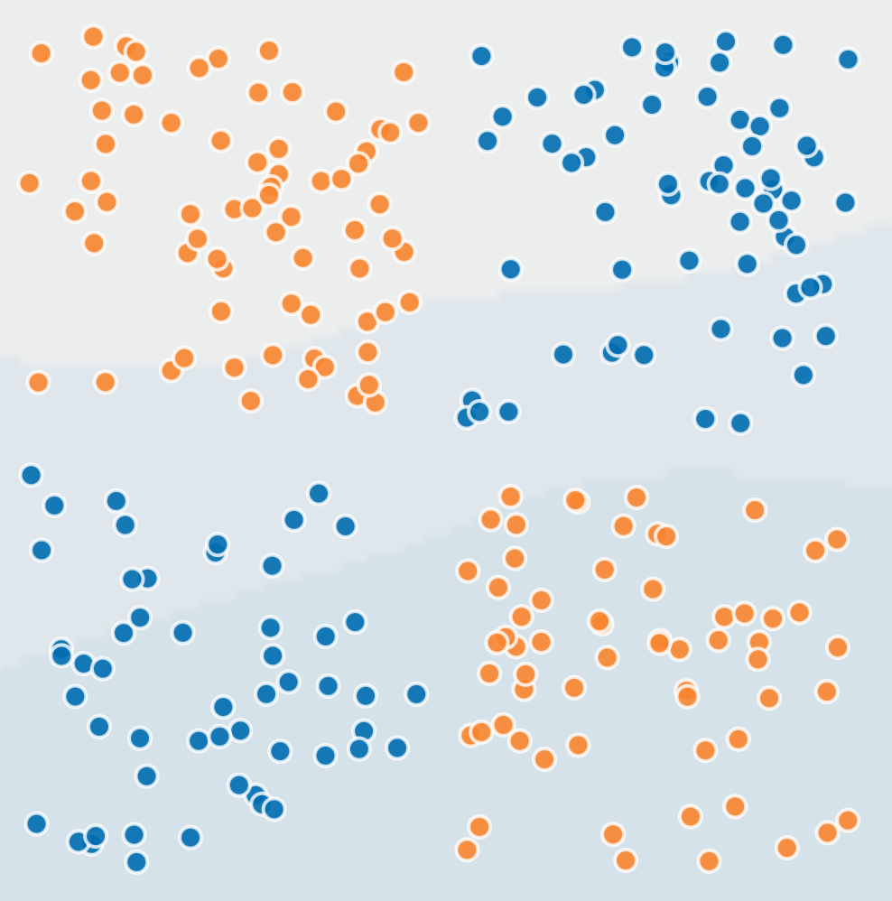
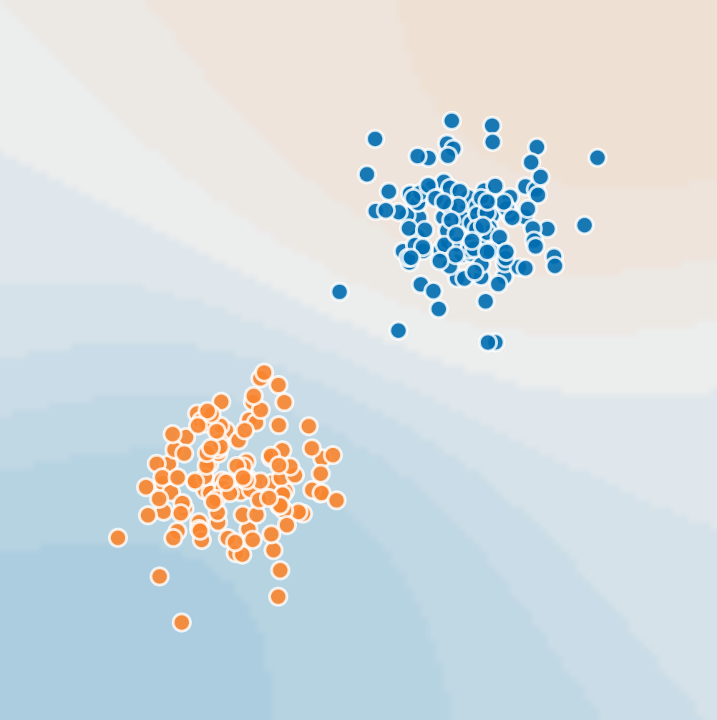
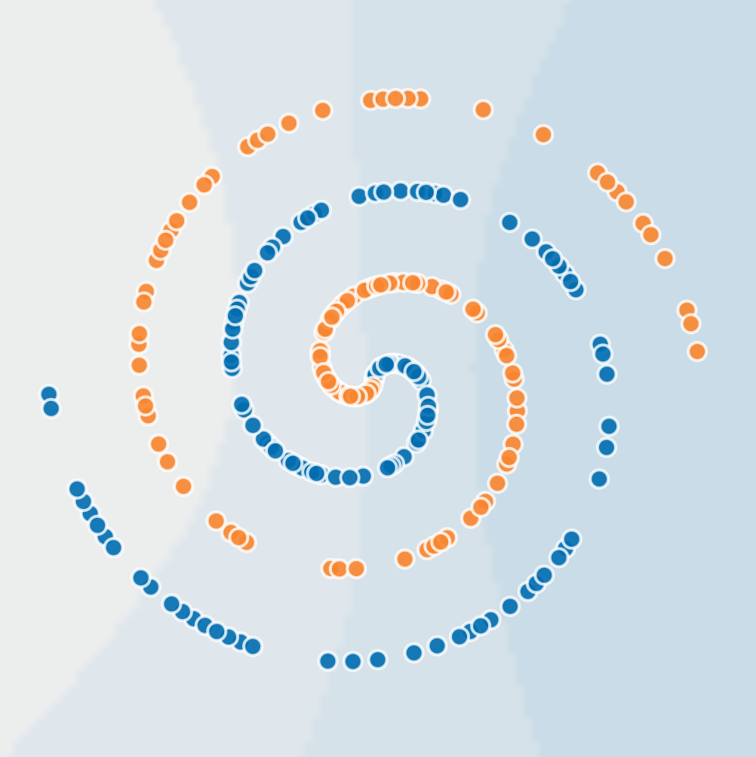
{01}
Fundamentals
Simple Predicting Machine
TENSORFLOW PLAYGROUND
Supervised Learning Problem (non-linear vs linear)
TENSORFLOW PLAYGROUND Problem type:
Problem type is broadly classified into two parts: classification and regression.
The TensorFlow Playground
provides four different types
of Learning problems (tasks) datasets that functions as Teachers (Targets):
(1) Circles,
(2) Exclusive OR [XOR],
(3) Gaussian
(4) Spiral
Through trial-and-error
we will determine which of the four learning tasks
can be typified as either Classification or Regression

Slide 20
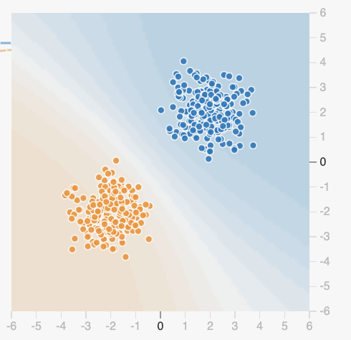
{01}
Fundamentals
Tensorflow Playground
Simple Predicting Machine
Teacher [Target] Datasets + learning task features:
Six datasets, each with 500 (x,y) points on a plane where x and y between -5 and +5
Points have labels of positive (orange) or negative (blue)
Two possible machine learning tasks:
Classification: Predict class of test points
Regression: find function to separate classes
Evaluation: split dataset into training and test, e.g., 70% training, 30% test

Slide 21
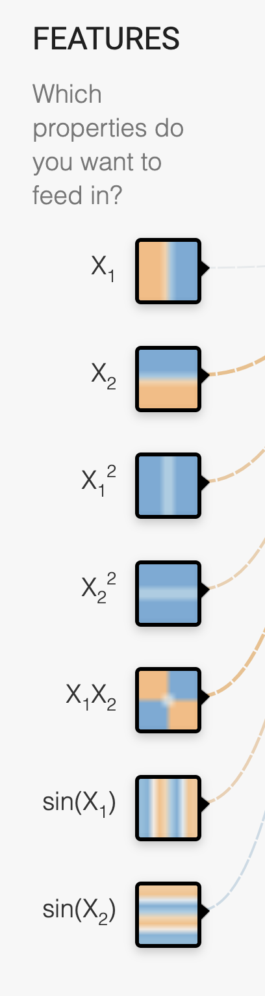
{01}
Fundamentals
Neural Network
Tensorflow Playground
hyperparameters
Simple Predicting Machine
Input features:
X₁ Point’s x value
X₂ Point’s y value
X₁² Point’s x value squared
X₂² Point’s y value squared
X₁X₂ Product of point’s x & y values
sin(X₁) Sine of point’s x value
sin(X₂) Sine of point’s y value

Slide 22
{01}
Fundamentals
Tensorflow Playground
Simple Predicting Machine
Supervised Training:
Supervised machine learning requires that a given neural network is trained adhereing to a learning Algor time, the tensorflowplayground uses BackPropagation.
The training process is divided into a series of epochs
In each epoch, all of the training data is run through the system to adjust the NN parameters
Process ends after a fixed # of epochs or when error rate flattens or starts increasing

Slide 23
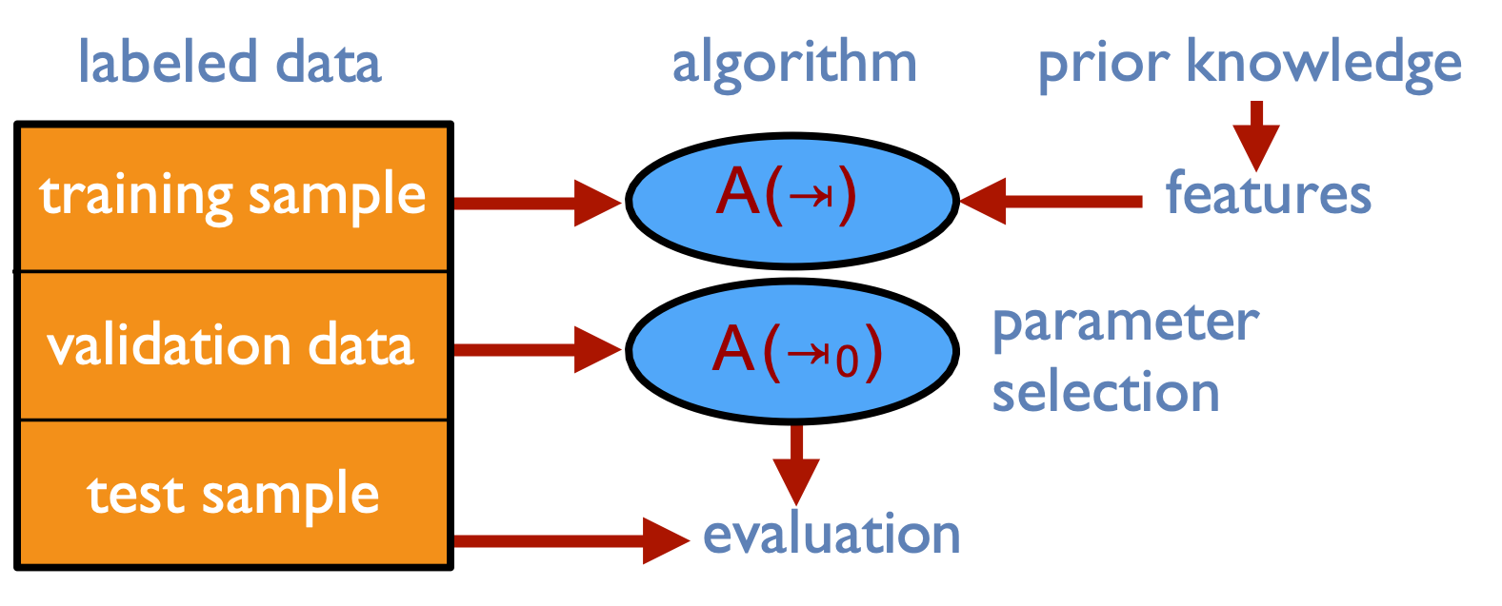
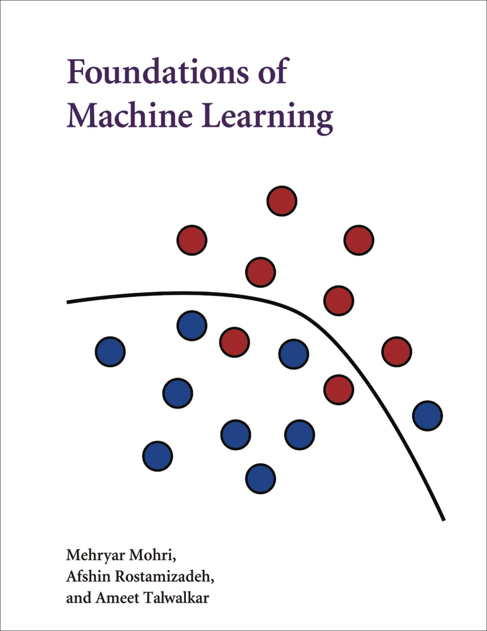
{01}
Fundamentals
Neural Network
direct & iterative (experimental)manipulation
through the Tensorflow Playground
Simple Predicting Machine
How do we find the best settings for a given learning problem/task?
Solution:
Experiment with a range of different hyperparameter settings such as:
learning rate,
activation function,
amount op inputs,
number of hidden layers
Teacher (regression or classification)
via multiple runs
https://cloud.google.com/blog/products/ai-machine-learning/understanding-neural-networks-with-tensorflow-playground

Slide 24
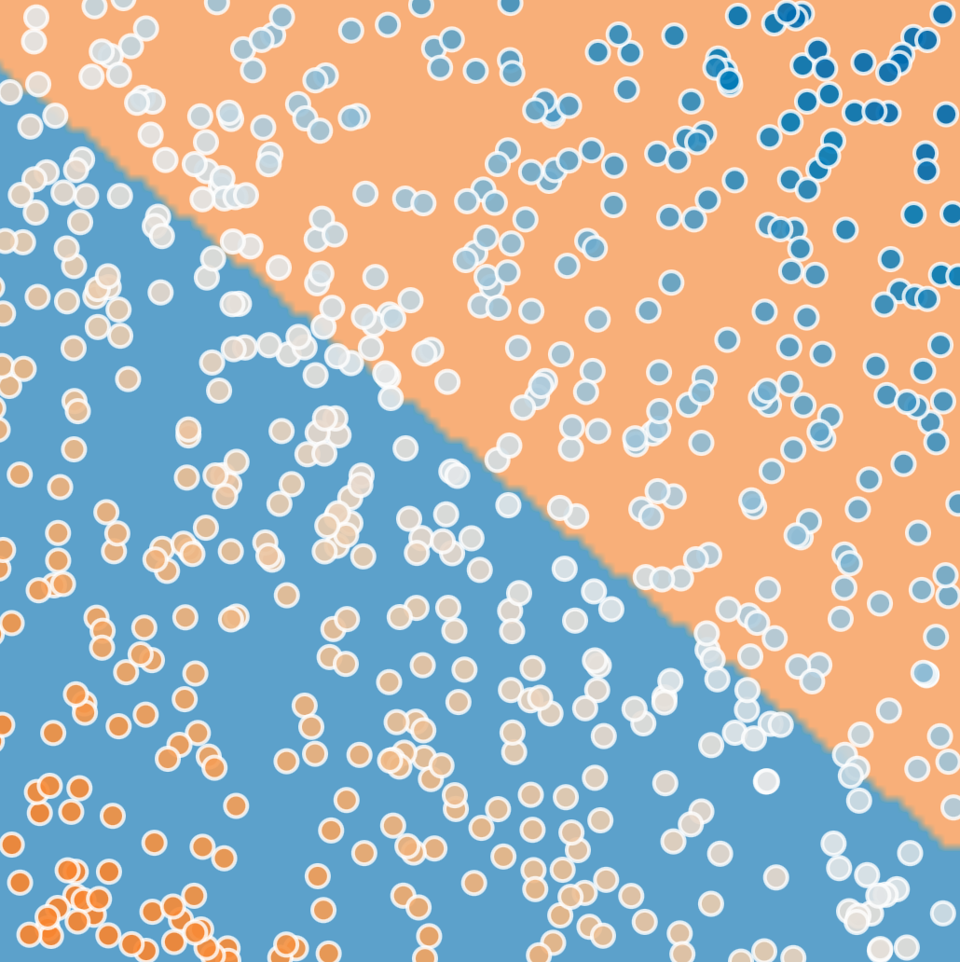
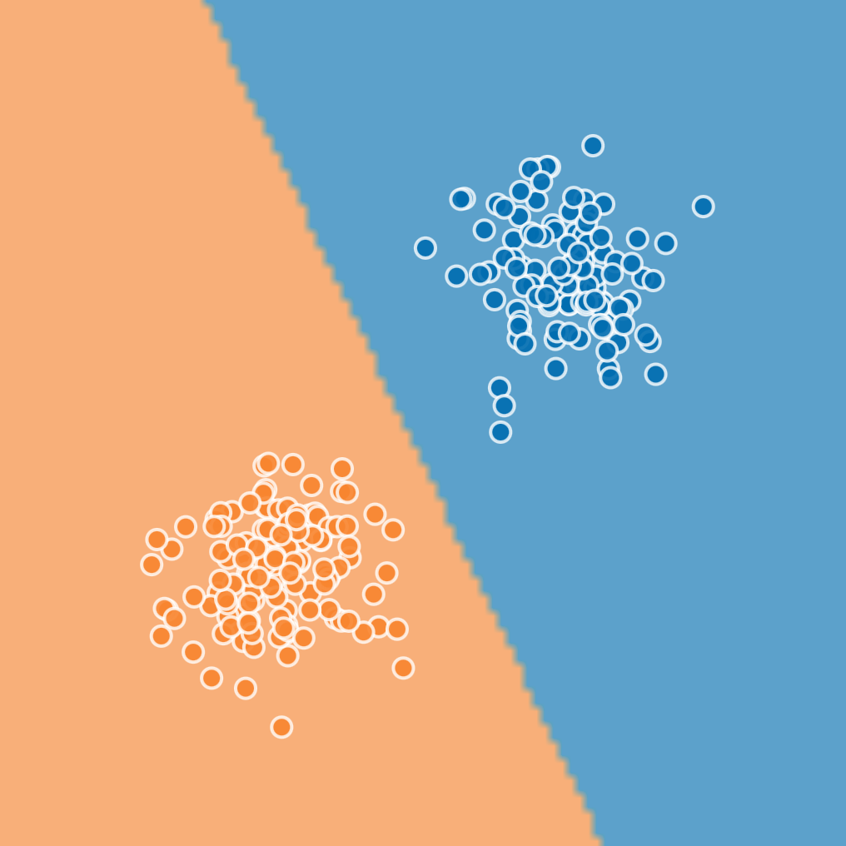
{01}
Fundamentals
Simple Predicting Machine
Neural Network
Experiment 01: Simulating a Perceptron
Learning Problem separate two type of data points
Let’s train a neural network and see whether it can separate two groups of data points by means of a perceptron alone.

Slide 25
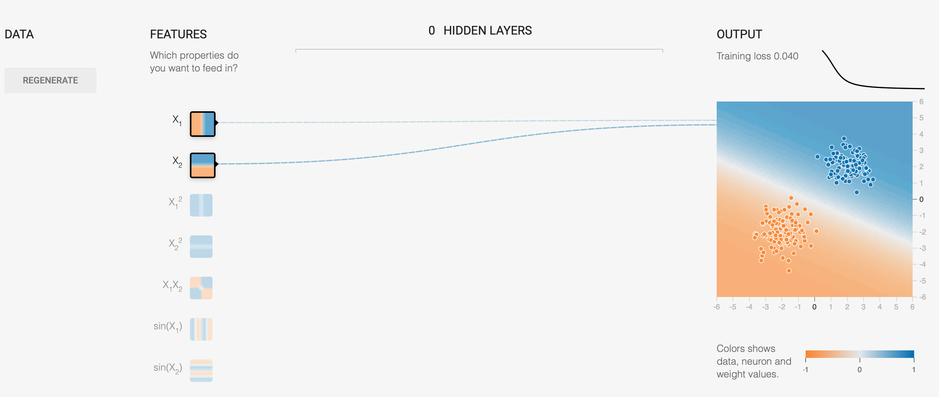
{01}
Fundamentals
Simple Predicting Machine
Neural Network
Experiment 01: Simulating a Perceptron
Learning Problem separate two type of data points
Let’s train a neural network and see whether it can separate two groups of data points by means of a perceptron alone.
SOLUTION:
https://cloud.google.com/blog/products/ai-machine-learning/understanding-neural-networks-with-tensorflow-playground

Slide 26
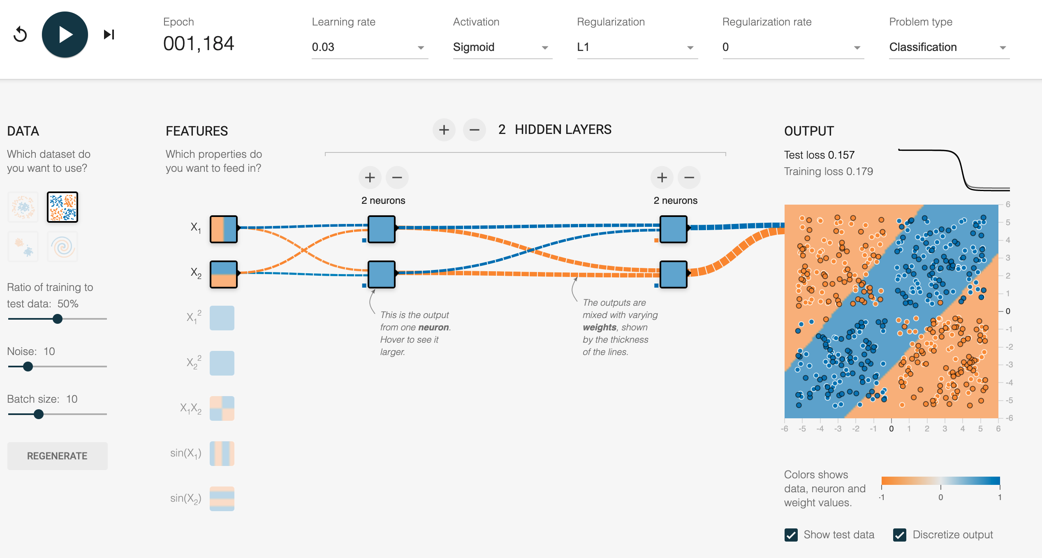
{01}
Fundamentals
Simple Predicting Machine
Neural Network
Experiment 02: solve the XOR problem

Slide 27
XOR Puzzle!

Slide 28
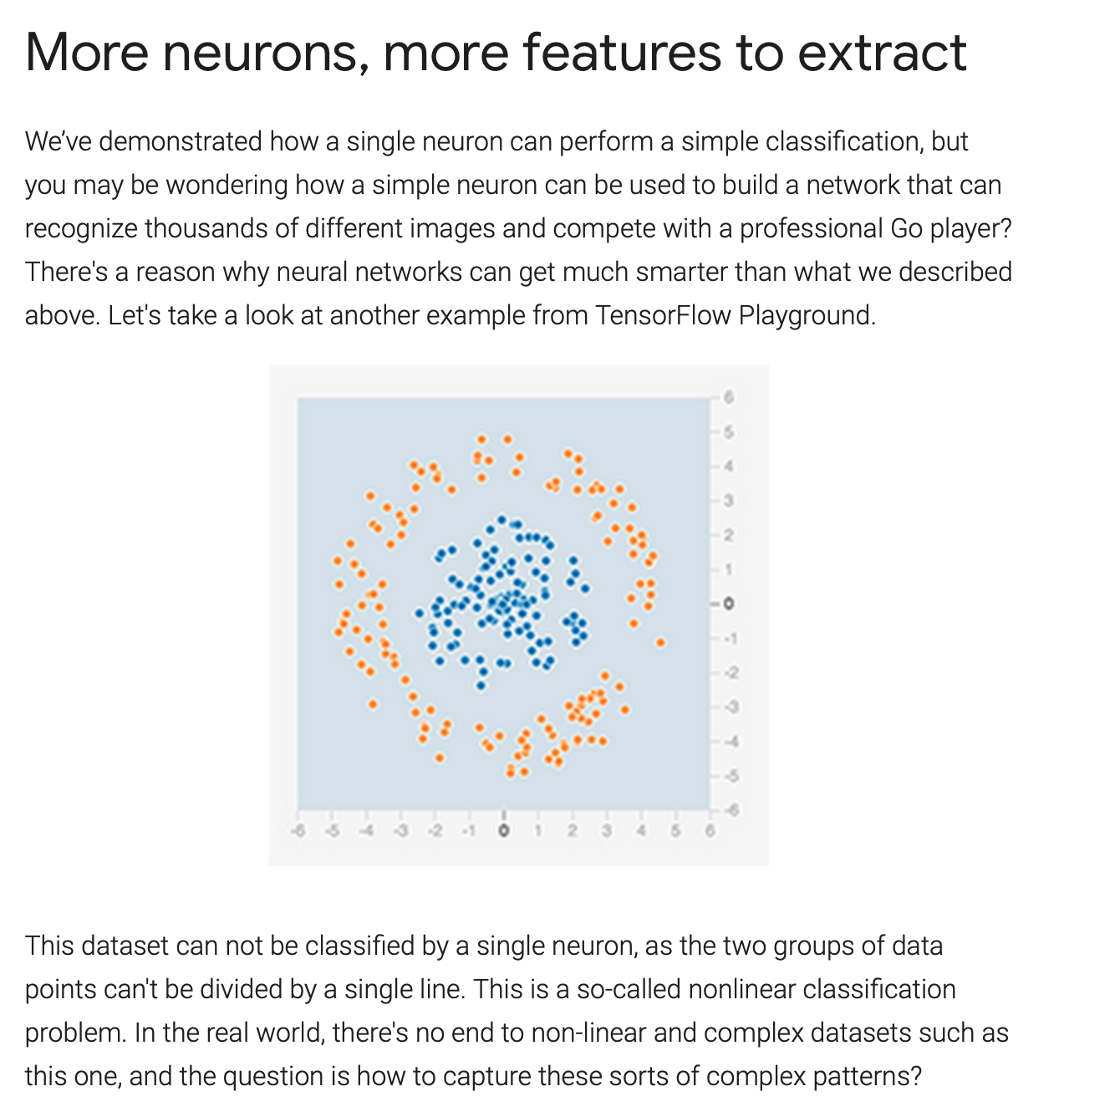
{01}
Fundamentals
Neural Network
Experiment 03: solve the CIRCLE problem
Simple Predicting Machine
https://cloud.google.com/blog/products/ai-machine-learning/understanding-neural-networks-with-tensorflow-playground

Slide 29
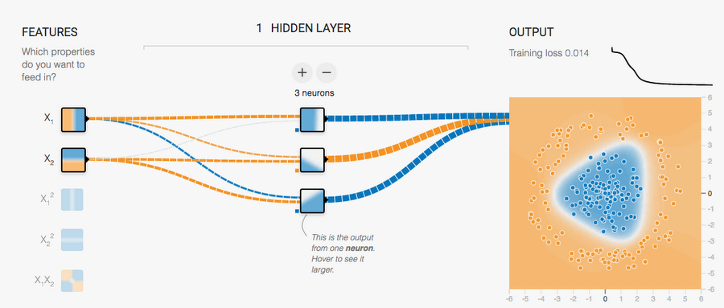
XOR Puzzle!
The solution is to add a hidden layer between the input values and output neuron. Click here to try it out.
What's happening here? If you click each one of the neurons in the hidden layer, you see they're each doing a simple, single-line classification:
The first neuron checks if a data point is on the left or right
The second neuron checks if it's in the top right
The third one checks if it's in the bottom right
These three results are called features of the data. Outputs from these neurons indicate the strength of their corresponding features.
Finally, the neuron on the output layer uses these features to classify the data. If you draw a three dimensional space consisting of the feature values, the final neuron can simply divide this space with a flat plane.
This is an example of a transformation of the original data into a feature space.

Slide 30
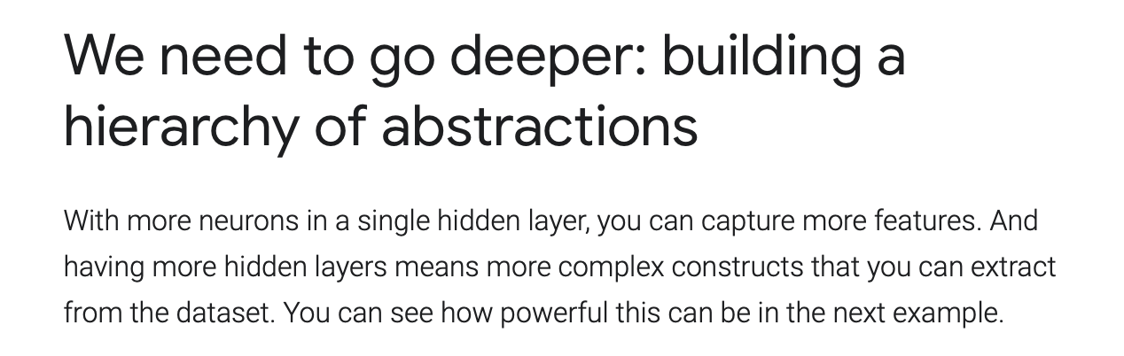
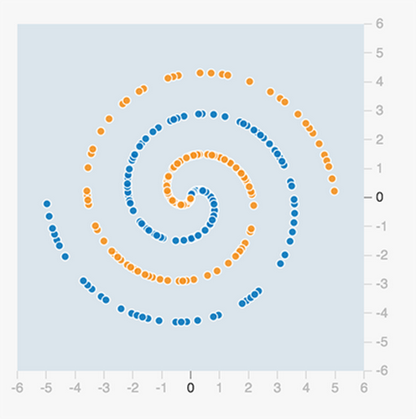
{01}
Fundamentals
Neural Network
Experiment 04: solve the SPIRAL problem
Simple Predicting Machine
https://cloud.google.com/blog/products/ai-machine-learning/understanding-neural-networks-with-tensorflow-playground

Slide 31
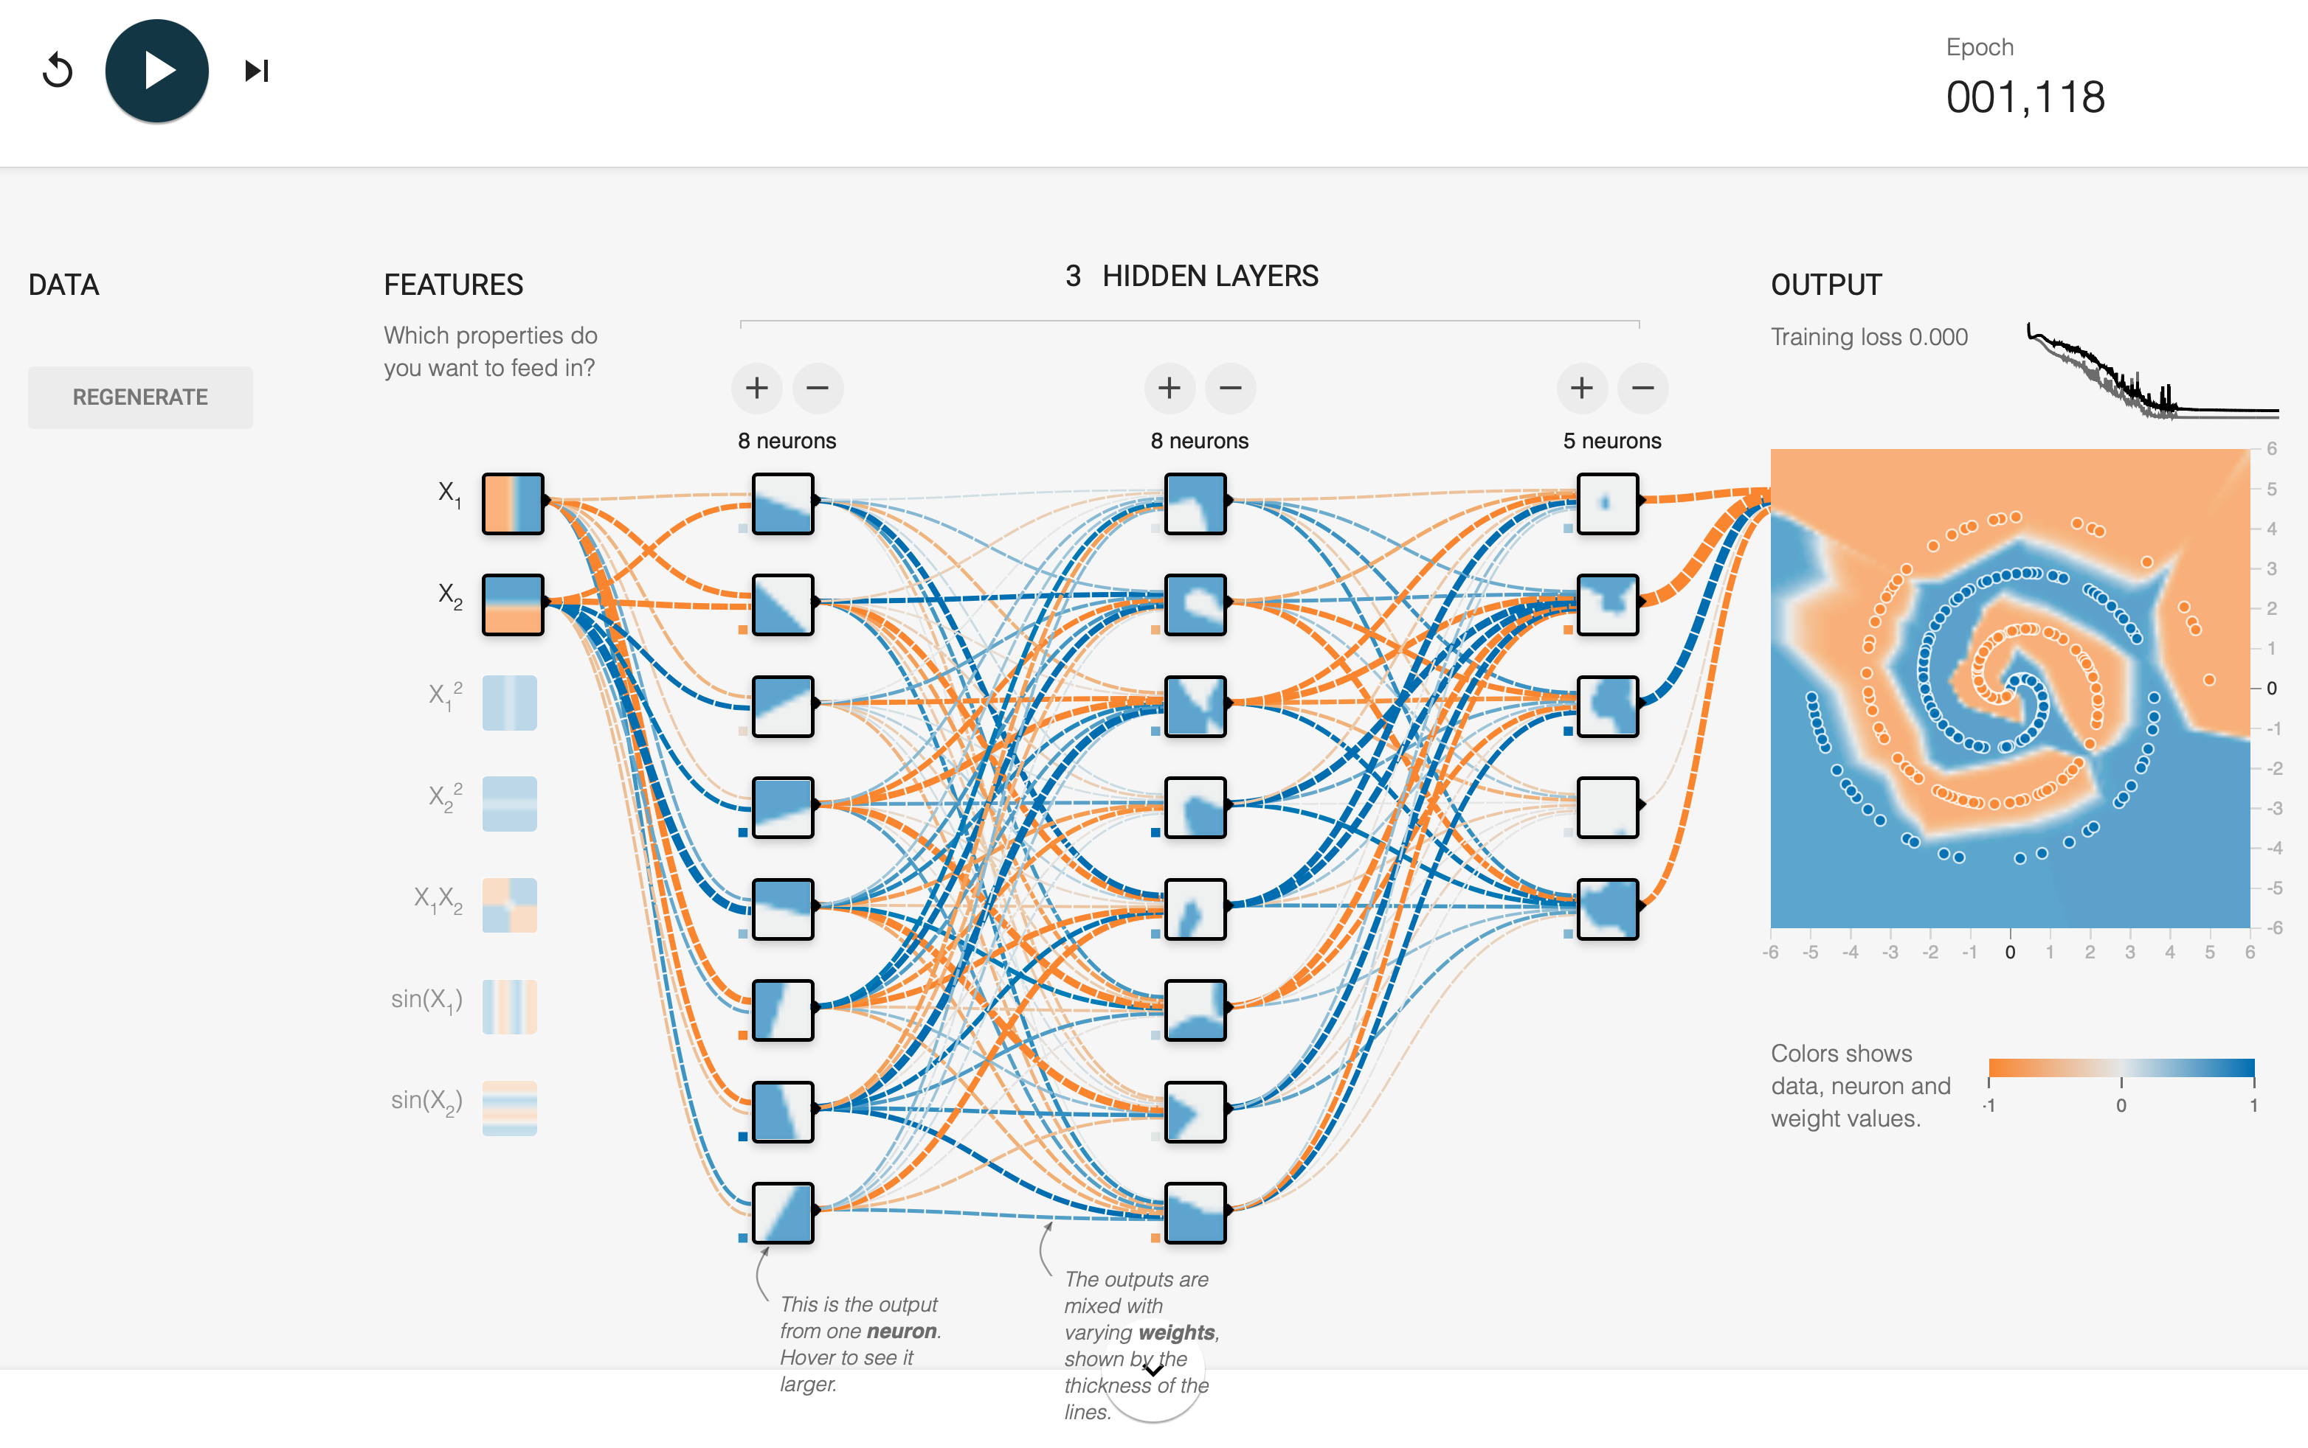
{01}
Fundamentals
Neural Network
Experiment 04: solve the SPIRAL problem
Simple Predicting Machine
Solution Click here to see it in action (it will take a couple of minutes to train).
https://cloud.google.com/blog/products/ai-machine-learning/understanding-neural-networks-with-tensorflow-playground

Slide 32
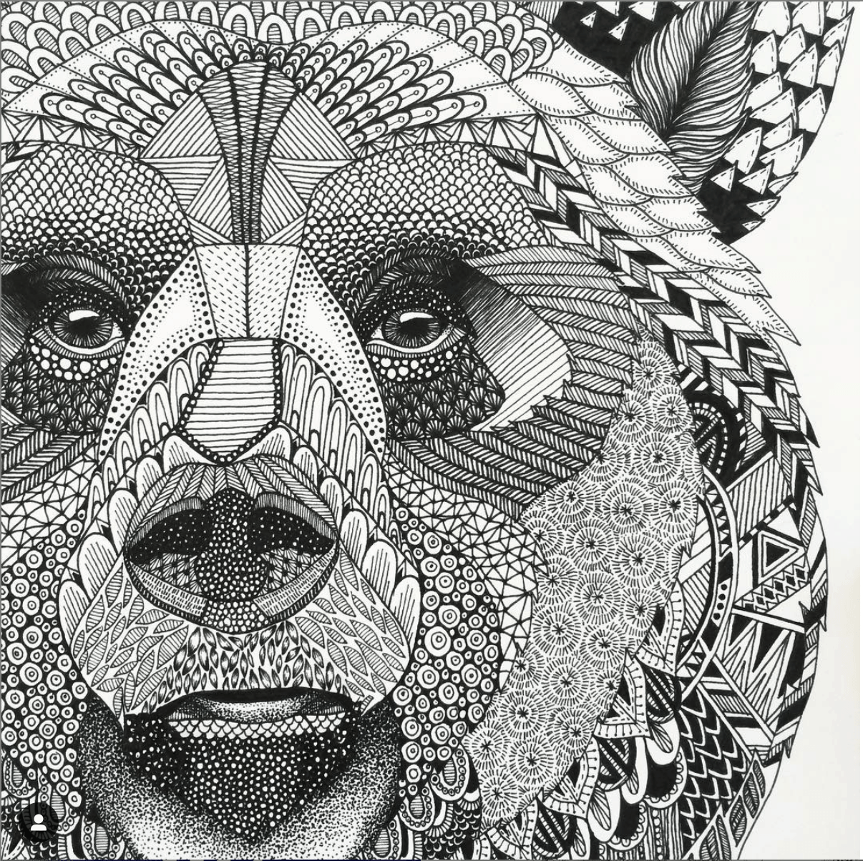
{04}
Do it Yourself
Do some online research.
Find examples of interactive NN + LM demonstration
Make a video wherein you demonstrate
What learning problem (task) is solved (classification / regression)
Explain the NN architecture
Describe he hyper-parameterisation you used to solve the problem
+ Describe in your own words what kind of data-product you to build
See: https://github.com/robvdw/RCA_AIG_042Q6_ARTIFICIAL_INTELLIGENCE

Slide 33
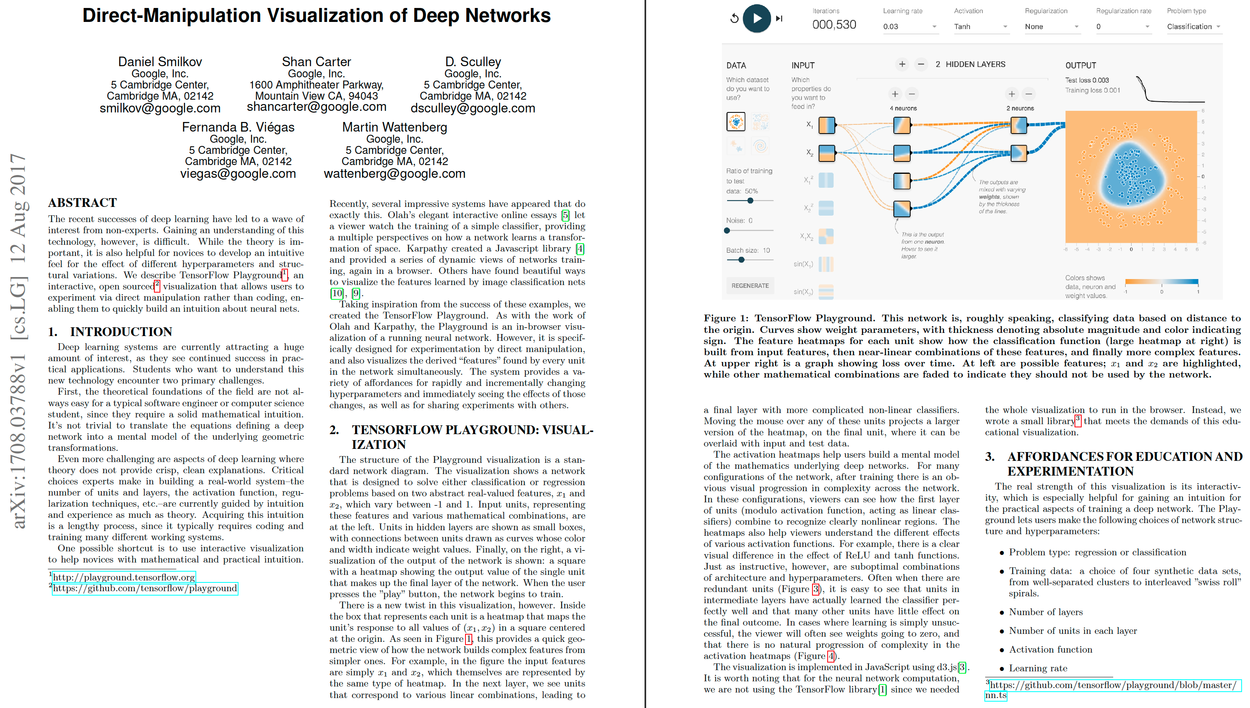
XOR Puzzle!

Slide 34
XOR Puzzle!

Slide 35
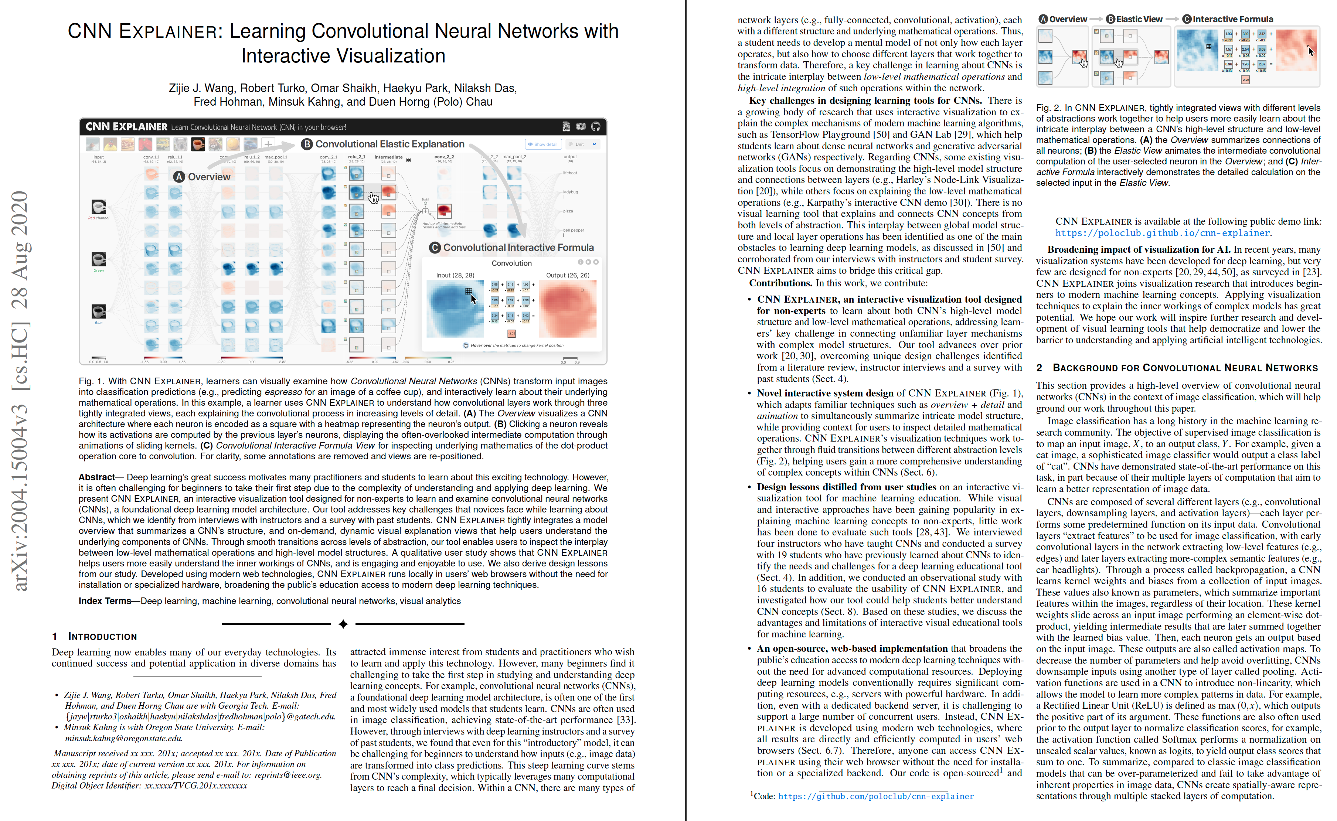
XOR Puzzle!

Slide 36
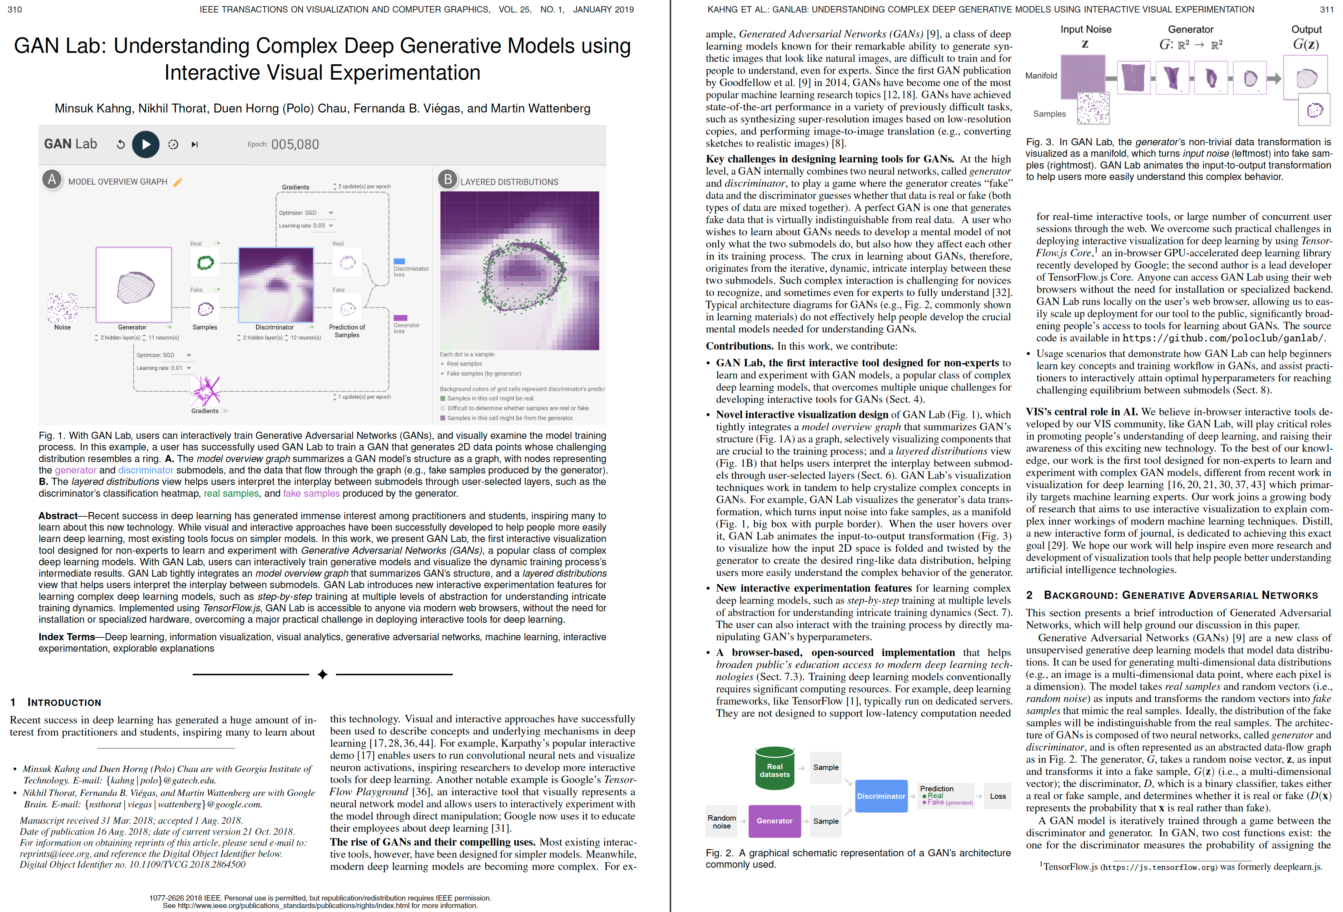
XOR Puzzle!

Slide 37


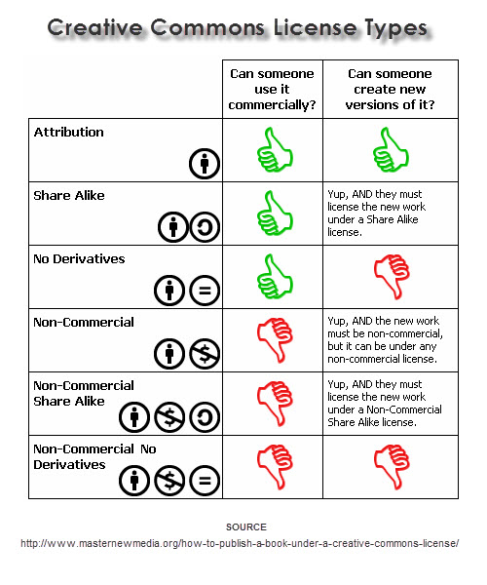
This lesson was developed by:
Robert Frans van der Willigen
CMD, Hogeschool Rotterdam
OKT 2020
http://creativecommons.org/licenses/by-nc-sa/3.0/
This lesson is licensed under a Creative Commons Attribution-Share-Alike license. You can change it, transmit it, show it to other people. Just always give credit to RFvdW.
http://empoweringthenatives.edublogs.org/2012/03/15/creative-commons-licenses/
http://creativecommons.org/licenses/

Slide 39
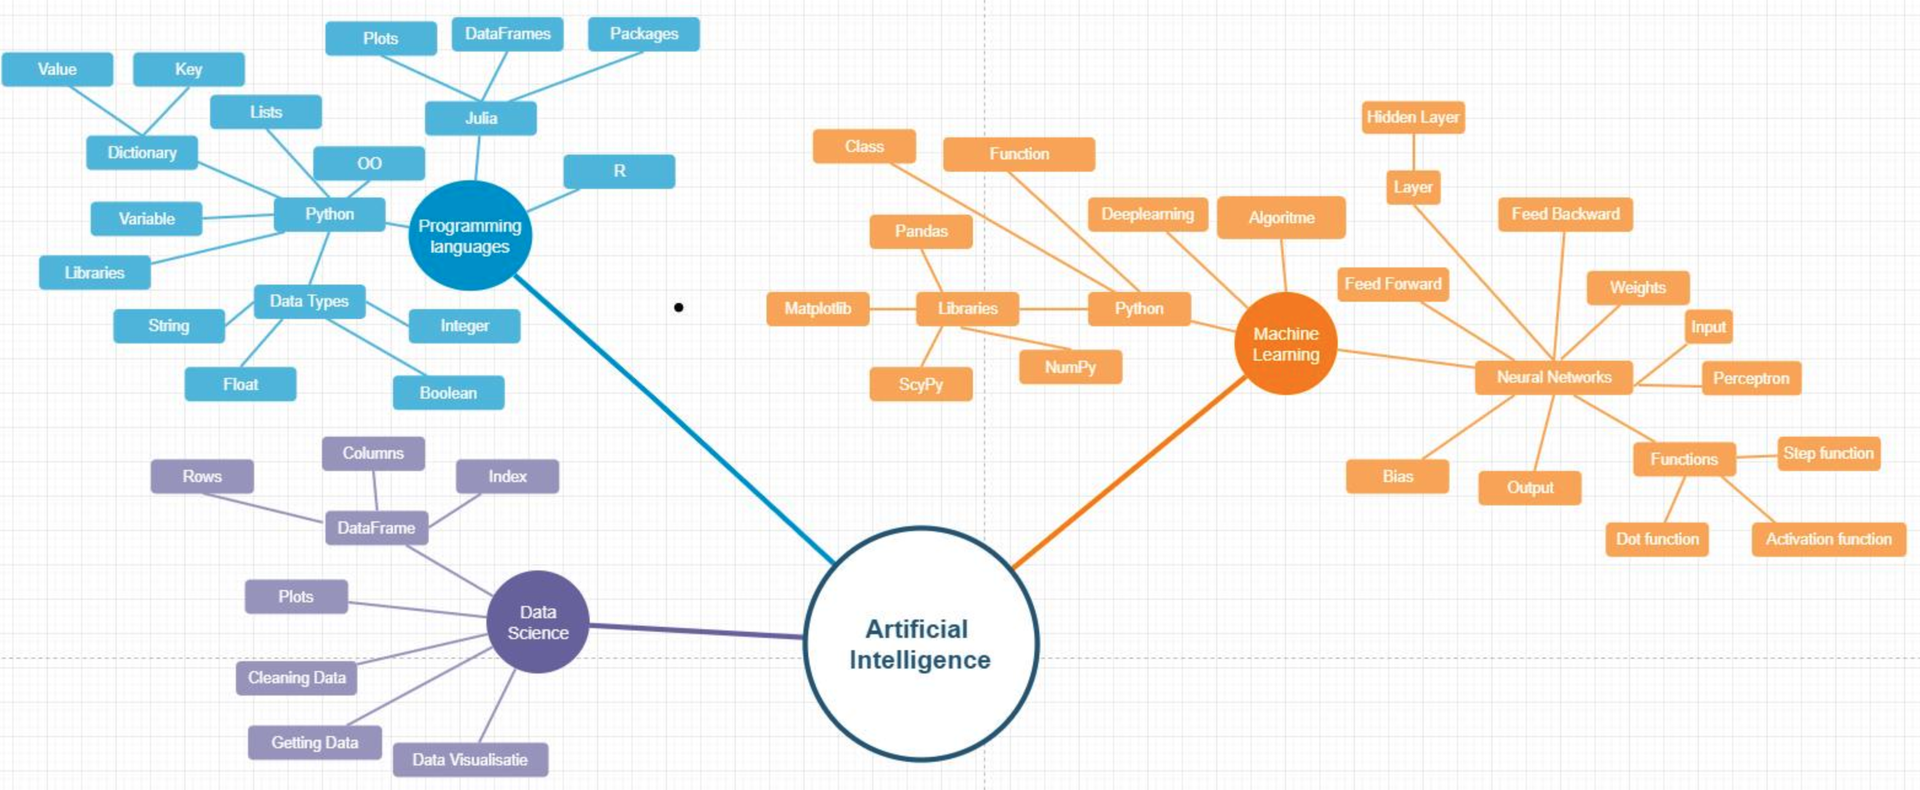
XOR Puzzle!
Raiklin Felicia (0786789)

Slide 40
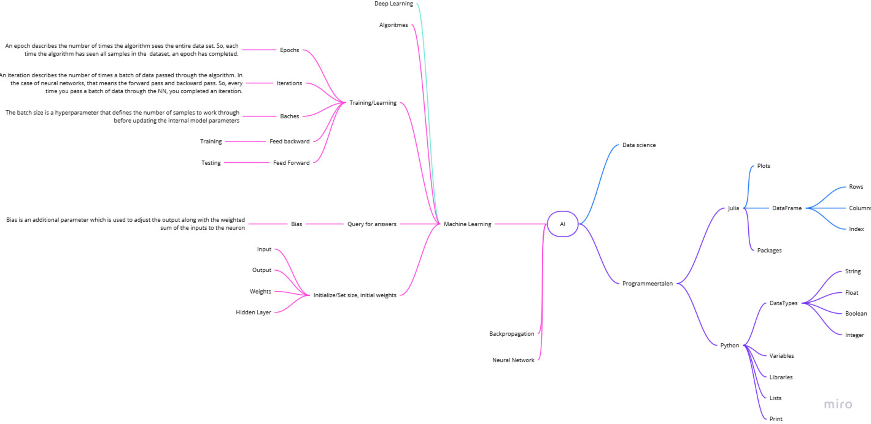
XOR Puzzle!
Jessy van Lier (0952765)

Slide 41
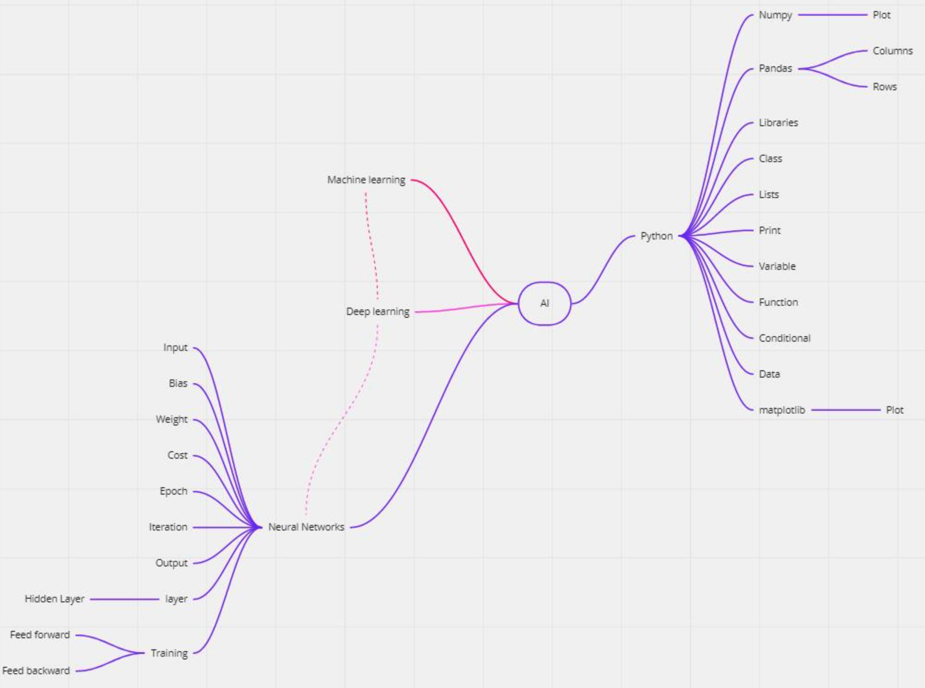
XOR Puzzle!
Yousef El Mokaddem (0950940)

Slide 42
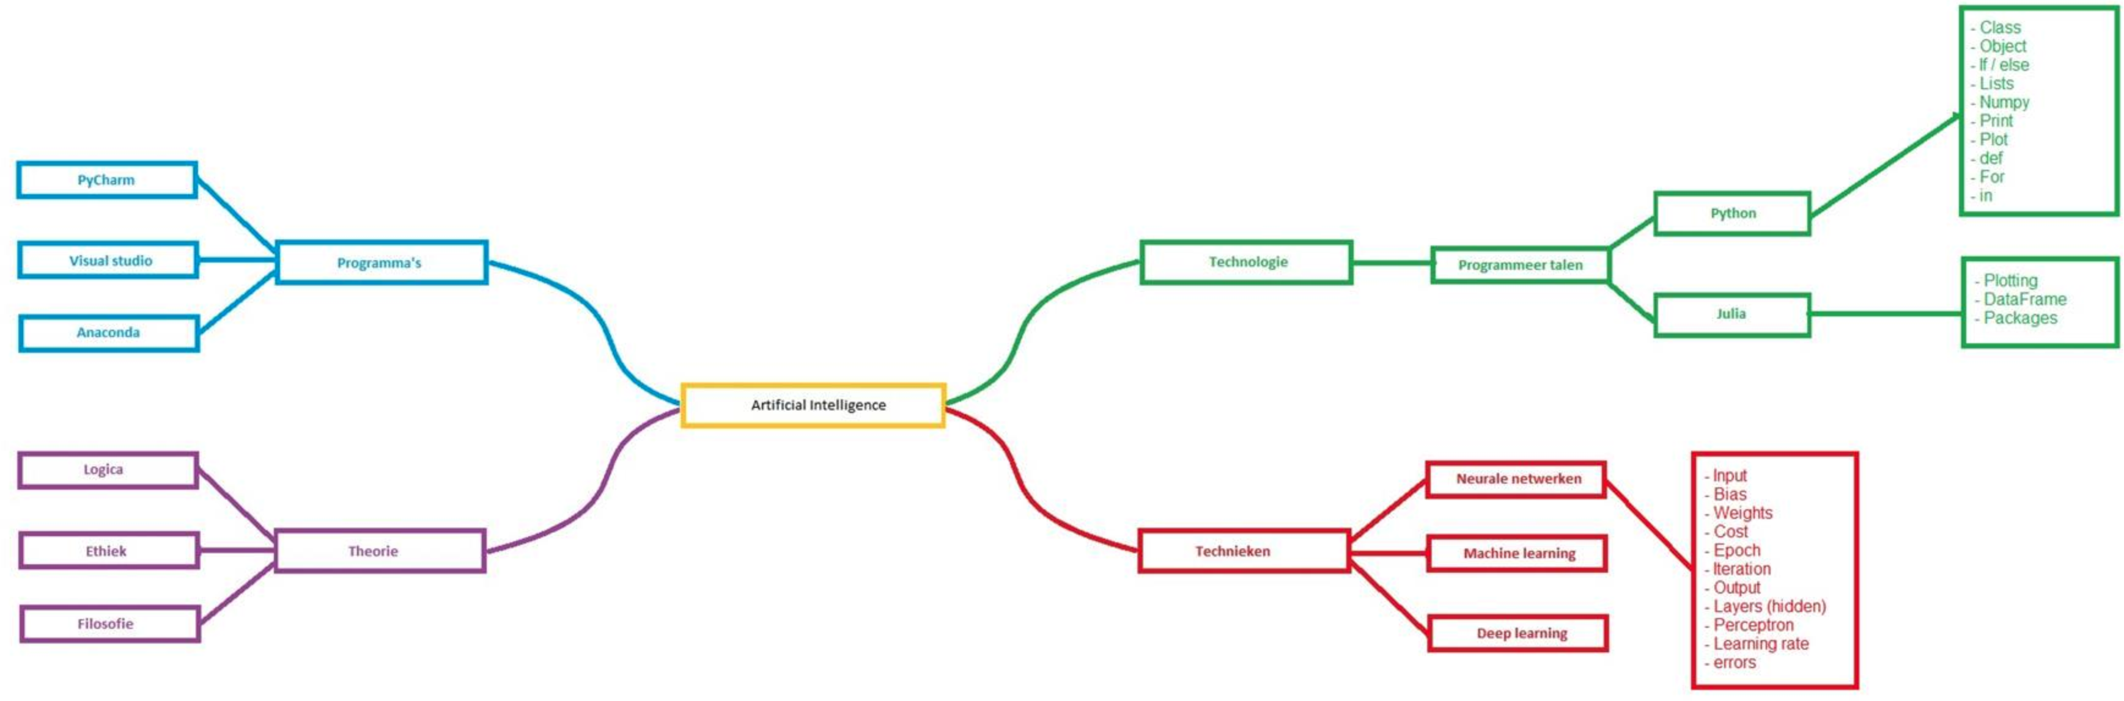
Mark Vollebregt (0951040)
XOR Puzzle!

Slide 43
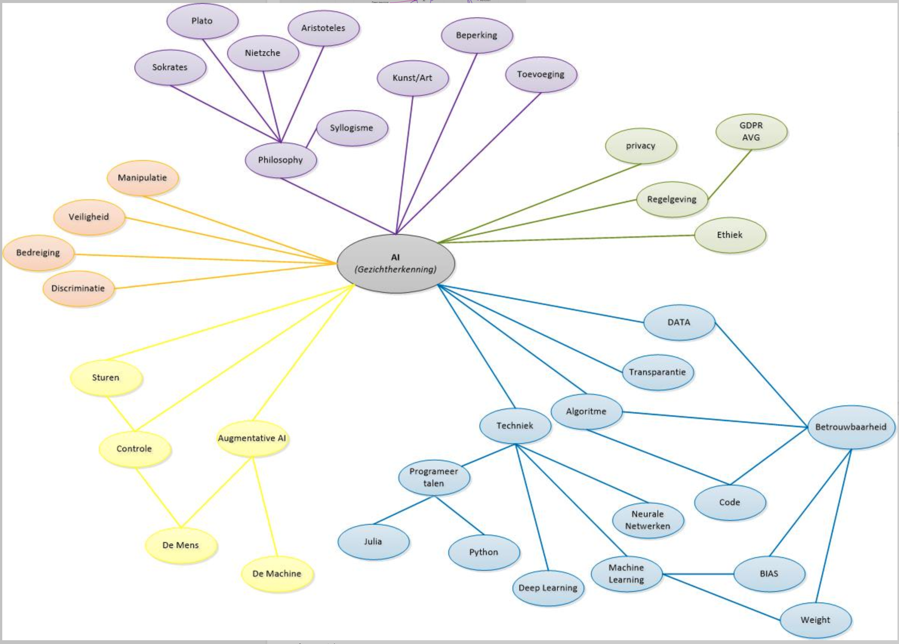
XOR Puzzle!
Martin Beverloo (0946822)

